Slide 1

Parasite 101
6 Week Parasite Challenge
Dr. Christine Schaffner
Drchristineschaffner.com

Slide 2
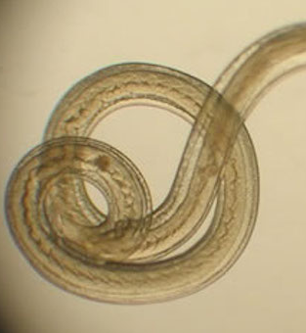
Straight from the CDC
“The perception that parasitic diseases are no longer relevant or important is a major impediment to implementing currently available control and prevention strategies,” the authors note.
“The Neglected Parasitic Infections in the United States are part of the global burden of parasitic diseases, and strategies that reduce or eliminate them in the United States can someday be applied globally.”

Slide 3
What are parasites?
A parasite is an organism that lives on or in a host organism and gets its food from or at the expense of its host.
There are three main classes of parasites that can cause disease in humans:
  Protozoa
  Helminths
  Ectoparasites

Slide 4
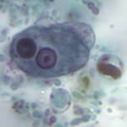
Protozoa
Protozoa are microscopic, one-celled organisms
Transmission of protozoa that live in a human's intestine to another human typically occurs through a fecal-oral route
Protozoa that live in the blood or tissue of humans are transmitted to other humans by an arthropod vector (for example, through the bite of a mosquito or sand fly)
  Sarcodina – the ameba, e.g., Entamoeba
  Mastigophora – the flagellates, e.g., Giardia, Leishmania
  Ciliophora – the ciliates, e.g., Balantidium
  Sporozoa – organisms whose adult stage is not motile e.g., Plasmodium, Cryptosporidium
Babesiosis is a disease caused by microscopic parasites that infect red blood cells, protozoa infection

Slide 5
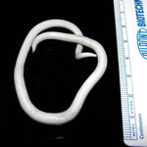
Helminths
Helminths are large, multicellular organisms that are generally visible to the naked eye in their adult stages.
  Flatworms (platyhelminths) – these include the trematodes (flukes) and cestodes (tapeworms).
  Thorny-headed worms (acanthocephalins) – the adult forms of these worms reside in the gastrointestinal tract. The acanthocephala are thought to be intermediate between the cestodes and nematodes.
  Roundworms (nematodes) – the adult forms of these worms can reside in the gastrointestinal tract, blood, lymphatic system or subcutaneous tissues. Alternatively, the immature (larval) states can cause disease through their infection of various body tissues. Some consider the helminths to also include the segmented worms (annelids)—the only ones important medically are the leeches. Of note, these organisms are not typically considered parasites.

Slide 6
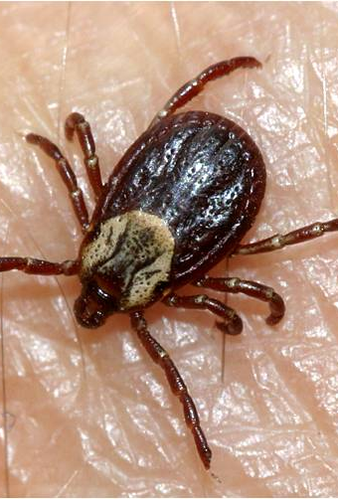
Ectoparasites
Although the term ectoparasites can broadly include blood-sucking arthropods such as mosquitoes (because they are dependent on a blood meal from a human host for their survival), this term is generally used more narrowly to refer to organisms such as ticks, fleas, lice, and mites that attach or burrow into the skin and remain there for relatively long periods of time (e.g., weeks to months).
Arthropods are important in causing diseases in their own right, but are even more important as vectors, or transmitters, of many different pathogens that in turn cause tremendous morbidity and mortality from the diseases they cause.

Slide 7
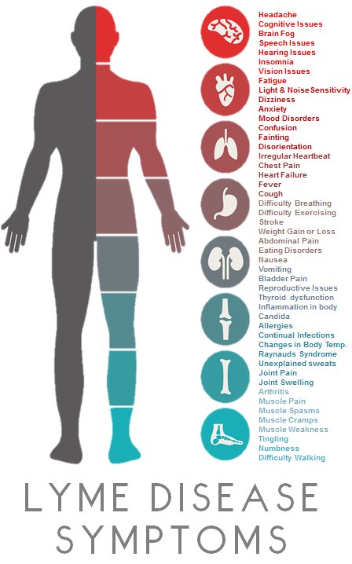
“Tick” Borne Infections/Lyme Disease
Borrelia
Babesia
Bartonella
Ehrlichia
Anaplasma
Rickettsia
Mycoplasma
Chlamydia pneumonia

Slide 8
Symptoms of Parasites
Abdominal pain
Diarrhea
Nausea or vomiting
Gas or bloating
Dysentery (loose stools containing blood and mucus)
Constipation
Rash or itching around the rectum or vulva
Stomach pain or tenderness
Feeling tired
Weight loss
Passing a worm in your stool
Anemia
Food cravings
Insomnia
Anxiety/Depression
Brain fog
Muscle pain
Low blood sugar
Allergies
Nutritional deficiencies
Seizures

Slide 9
How do we become susceptible to parasitic infections?
Chronic infections and immune suppression
  Lyme
  Retroviruses
  Mold
Environmental toxicity
  Heavy Metals
  Herbicides
  Electrosmog
Compromised Microbiome
5 levels of healing

Slide 10
Heavy Metals and Parasites
(Quotes from Dr. K)
Many of the parasitic worms, ascaris, tape works, echinococcus, hook worms (there are many of them) have the ability to extract from you your lead, your mercury and condense it into your body.
There are numerous published—actually, one of the key sentences in some of these articles is parasites acts as sinks for the pollutants of the host. That’s sort of the key sentence. If you google that, you’ll find a number of articles published on that.
And so, in reverse engineering, why do we have parasites? The first thing is that we’re toxic. And it is a body that can no longer administrate the microbiome that we have. If there are too many pathogens or too many toxins in our system, the biology is very, very clever. It resorts to a second tier of defenses. One of them is to grow parasites.
Parasites that otherwise would not have made it into our system are now flourishing in us, and in fact are, to a large degree, symbiotic (that means they actually help us survive the toxic environment). They’re very misunderstood.

Slide 11
Klinghardt Axiom
For each unresolved psycho-emotional conflict or trauma there is an equivalent of stored toxins and an equivalent of pathogenic microorganisms. To successfully detoxify the body the three issues have to be addressed simultaneously.”
The "Klinghardt Axiom" states "The body always strives to achieve equilibrium between stored unresolved emotional issues, toxins, and the presence of pathogenic microbes." It is only through a well-planned treatment protocol that considers all of these factors that the patient will return to a state of wellness.

Slide 12
Common Parasites I see in Practice
Liver flukes
Schistosomiasis
Strongyloides
Roudworm
Tapeworm
Ascaris
Giardia
Amoebas

Slide 13
Why are they so hard to test for?
Stool Testing
  GI MAP
  Diagnostechs
  Parawellness
Questionnaires:
  https://drtoddwatts.com
Clues in lab work
  High Eosinophils
  Low Alk phos, low B12
  Anemia

Slide 14
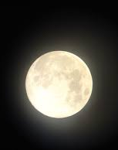
Moon Cycle
“This is the time when the parasites detach from the walls of the organs and intestinal lining to breed and lay eggs. Any natural worming program should last seven to 14 days to allow the parasites to complete the breeding cycle and the new eggs to hatch.”
“It has to do with the cycles of the moon. As it was explained to us, the gravitational pull of the moon on all bodies of water on earth effects the activity level of living organisms by expanding or contracting the water within them. The water content in parasites expands as the moon goes from barely visible to a full moon. As this happens the parasites become more irritable and will increase their consumption of nutrients. Giving parasite remedies during this time results in more effective elimination using lower doses. This has become standard procedure in our treatment plan and it works!” Dr. D’Angelo

Slide 15
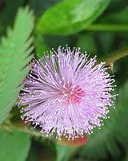
Common Strategies
Mimosa pudica
  Biopure
  Para 1
Suppositories
  Nexus-Artemesia/Garlic
  Idalia-Ozonated Artesmesia/Clove
Neem
  Biopure
  Para 2
O3 oils-ozonated oils
Paraficus-freez dried figs
Aromatabs
Antiparasitic medications
Gubarev enemas
Nebulizer
Treatment takes time, persistence, and consistency

Slide 16
What is Die Off
Herxheimer reaction
  A Jarisch–Herxheimer reaction is a reaction to endotoxin-like products released by the death of harmful microorganisms within the body during antibiotic treatment. Efficacious antimicrobial therapy results in lysis (destruction) of bacterial cell membranes, and in the consequent release into the bloodstream of bacterial toxins, resulting in a systemic inflammatory response.
Essentially, more biotoxins are being released than the body can adequately cope with at one time and may be a sign the system’s elimination pathways (liver, kidneys, & bowels) are overburdened or blocked (as in constipation or liver congestion)

Slide 17
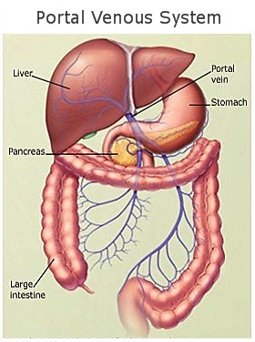
Importance of Detox Therapies
Coffee enemas
Colonics
Castor oil packs
Lymph drainage
Sweating
Hydration
Ionic foot baths
Binders!

Slide 18
Binders
Binders attach to toxic metals, chemicals, bio-toxins, etc, and shuttle them out of the digestive tract, preventing reabsorption via enterohepatic recirculation
Protect the kidneys
  Toxins are excreted through the feces instead of being absorbed by the bloodstream where the kidneys are required to filter them out
A general rule is to take binders 30 minutes prior to eating or 1 hour after eating and away from taking any supplements or medications
Stay hydrated to prevent constipation
Essential for any protocol

Slide 19
Binders
Chlorella: Chlorella is algae that has a high affinity for heavy metals, but also volatile organic compounds (VOCs), pesticides, herbicides, and mycotoxins. Because chlorella is a living organism, it has evolved to bind only to toxic metals, not essential minerals. For this reason, it can be used long term with no risk of nutritional deficiency over time. It is also a good idea to take chlorella before eating any higher mercury fish, such as tuna or swordfish.
Chlorella is algae that has a high affinity for heavy metals, but also volatile organic compounds (VOCs), pesticides, herbicides, and mycotoxins. Because chlorella is a living organism, it has evolved to bind only to toxic metals, not essential minerals. For this reason, it can be used long term with no risk of nutritional deficiency over time. It is also a good idea to take chlorella before eating any higher mercury fish, such as tuna or swordfish.
Charcoal: A very broad-spectrum binder that will bind a little bit of everything. This means it will bind toxins, as well as vitamins and minerals. For this reason, it is best used for acute situations, not long term.
Clays: Zeolite, bentonite, and pyrophyllite clays fall somewhere in between chlorella and charcoal. Clays are more selective to binding toxins than charcoal, but can still bind to nutrients. They are most commonly used for binding to biotoxins from mold and other microbes but can bind to other toxins as well. Clays are usually used for weeks to months at a time.
Enterosgel: A silica-based gel that has a high affinity for aluminum. It is also good for binding to gut endotoxins and is marketed to be used for food poisoning. It has a low affinity for vitamins and minerals.
Silica-Rich Mineral Waters: Silica easily obtained through mineral water can bind to aluminum.
Biosil and Other Silica Products: Bind mostly to aluminum, but also other trivalent metals like thallium and tin.
Cholestyramine and Welchol: These are prescription medications that were developed to bind cholesterol. They are commonly used to bind to mycotoxins, but they can decrease absorption of fat-soluble vitamins over time.
Chitosan: A compound derived from crustaceans that has a binding ability almost identical to welchol.
Modified Citrus Pectin: A fiber made from the peel of citrus fruits that has a high affinity for lead, but also other heavy metals. It also has some immune-modulating properties.
Fiber: Plant fibers have a weak affinity for many different toxins. Fiber can easily be obtained through the diet or supplemented.
Humic and Fulvic Acids: These are made of decomposed plant matter, essentially dirt. They have been shown to detox glyphosate.
Microsilica: A specially designed silica molecule that has a very high affinity for heavy metals.

Slide 20
Parasite Treatment needs a Comprehensive Treatment Approach
Strengthen Immune System
Support the Microbiome
Support Organs of Elimination
Always Include Binders
Rotate Strategies
Are there interference fields that need to be addressed?
Reflect on what parasitic energies do you have in your life
Reflect on unresolved trauma

